Slide 1
Inheritance in JAVA

Slide 2
Inheritance in Java is a mechanism in which one object acquires all the properties and behaviors of a parent object.
The idea behind inheritance in Java is that we can create new classes that are built upon existing classes.
When we inherit methods from an existing class, we can reuse methods and fields of the parent class. However, we can add new methods and fields in your current class also.

Slide 3
Why Do We Need Java Inheritance?
Code Reusability
Method Overriding
Abstraction

Slide 4
The syntax of Java Inheritance
class Subclass-name extends Superclass-name
{
//methods and fields
}

Slide 5
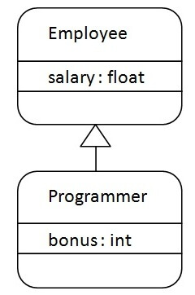

Slide 6
class Employee{
float salary=40000;
}
class Programmer extends Employee{
int bonus=10000;
public static void main(String args[]){
Programmer p=new Programmer();
System.out.println(p.salary);
System.out.printlnp.bonus);
}
}

Slide 7
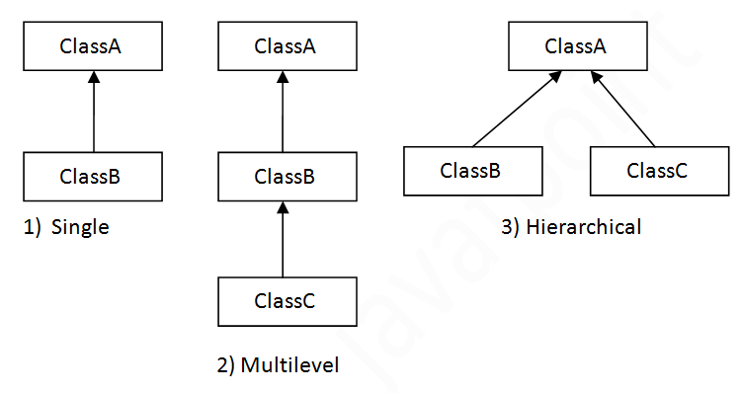

Slide 8
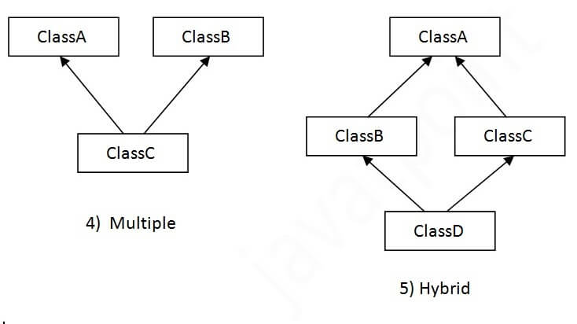

Slide 9
class Animal{
void eat(){System.out.println("eating...");}
}
class Dog extends Animal{
void bark(){System.out.println("barking...");}
}
class BabyDog extends Dog{
void weep(){System.out.println("weeping...");}
}

Slide 10
class TestInheritance2
{
public static void main(String args[])
{
BabyDog d=new BabyDog();
d.weep();
d.bark();
d.eat();
}
}

Slide 11
class Animal{
void eat()
{
System.out.println("eating...");}
}
class Dog extends Animal{
void bark()
{
System.out.println("barking...");}
}
class Cat extends Animal{
void meow()
{
System.out.println("meowing...");}
}

Slide 12
class TestInheritance3{
public static void main(String args[])
{
Cat c=new Cat();
c.meow();
c.eat();
//c.bark();//C.T.Error
}
}

Slide 13
Why multiple inheritance is not supported in Java?
To reduce the complexity and simplify the language, multiple inheritance is not supported in java.

Slide 14
Suppose there are three classes A, B, and C. The C class inherits A and B classes.
If A and B classes have the same method and we call it from child class object, there will be ambiguity to call the method of A or B class.
Since compile-time errors are better than runtime errors, Java renders compile-time error if you inherit 2 classes.
So whether you have same method or different, there will be compile time error.

Slide 15
class A{
void msg(){System.out.println("Hello");}
}
class B{
void msg(){System.out.println("Welcome");}
}
class C extends A,B{//suppose if it were
public static void main(String args[]){
C obj=new C();
obj.msg();//Now which msg() method would be invoked?
}
}

Slide 16
However, Java supports multiple inheritance through interfaces, where a class can implement multiple interfaces.

Slide 17
Abstract Class
A class that is declared with the abstract keyword is known as an abstract class in Java.
It can have abstract and non-abstract methods (method with the body).

Slide 18
An abstract class in Java acts as a partially implemented class that itself cannot be instantiated.
It exists only for subclassing purposes, and provides a template for its subcategories to follow.
Abstract classes can have implementations with abstract methods.
Abstract methods are declared to have no body, leaving their implementation to subclasses.

Slide 19
Points to Remember
An abstract class must be declared with an abstract keyword.
It can have abstract and non-abstract methods.
It cannot be instantiated.
It can have constructors and static methods also.
It can have final methods which will force the subclass not to change the body of the method.

Slide 20
public abstract class Shape {
public abstract double area();
public void display() {
System.out.println("This is a shape.");
}
}

Slide 21
abstract class Bike{
abstract void run();
}
class Honda4 extends Bike{
void run(){
System.out.println("running safely");
}
public static void main(String args[]){
Bike obj = new Honda4();
obj.run();
}
}

Slide 22
Interface
Interface is a reference type that acts as a blueprint for classes.
It contains abstract methods (methods without a body) and constants.
An interface is used to achieve abstraction and multiple inheritance in Java.

Slide 23
Key Characteristics of an Interface
Abstract Methods Only: By default, all methods in an interface are public and abstract (before Java 8).
Constant Fields: Variables in an interface are implicitly public, static, and final.
No Constructors: Interfaces cannot have constructors since they cannot be instantiated.

Slide 24
Key Characteristics of an Interface
Multiple Inheritance Support: A class can implement multiple interfaces, overcoming Java’s limitation of single inheritance.
Implementation by Classes: A class must implement all methods of an interface unless it is an abstract class.

Slide 25
Defining an Interface
// Defining an interface
interface Animal {
void makeSound();
}

Slide 26
// Implementing the interface
class Dog implements Animal {
public void makeSound() {
System.out.println("Woof! Woof!");
}
}
public class InterfaceExample {
public static void main(String[] args) {
Animal myDog = new Dog();
myDog.makeSound(); // Output: Woof! Woof!
}
}

Slide 27
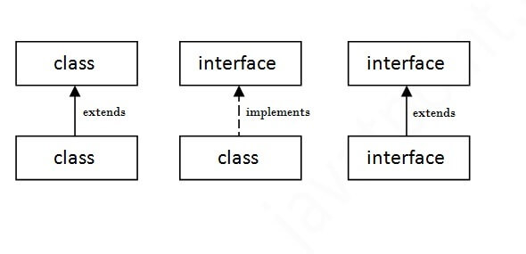

Slide 28
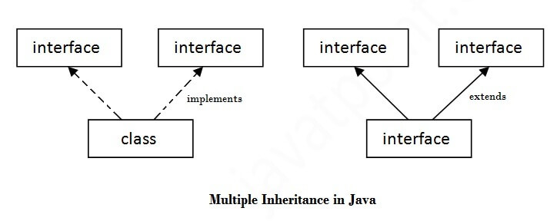
Multiple Inheritance in Java

Slide 29
interface Printable{
void print();
}
interface Showable{
void show();
}

Slide 30
class A7 implements Printable,Showable{
public void print(){System.out.println("Hello");}
public void show(){System.out.println("Welcome");}
public static void main(String args[]){
A7 obj = new A7();
obj.print();
obj.show();
}
}

Slide 31
Points | Abstract Class | Interface
Definition | Cannot be instantiated; contains both abstract (without implementation) and concrete methods (with implementation) | Specifies a set of methods a class must implement; methods are abstract by default.
Implementation Method | Can have both implemented and abstract methods. | Methods are abstract by default; Java 8, can have default and static methods.
Inheritance | class can inherit from only one abstract class. | A class can implement multiple interfaces.
Access Modifiers | Methods and properties can have any access modifier (public, protected, private). | Methods and properties are implicitly public.
Variables | Can have member variables (final, non-final, static, non-static). | Variables are implicitly public, static, and final (constants).

Slide 32
Method Overriding in Java
If subclass (child class) has the same method as declared in the parent class, it is known as method overriding in Java.
In other words, If a subclass provides the specific implementation of the method that has been declared by one of its parent class, it is known as method overriding.

Slide 33
Rules for Java Method Overriding
Same Method Name: The overriding method in the subclass must have the same name as the method in the superclass that it is overriding.
Same Parameters: The overriding method must have the same number and types of parameters as the method in the superclass. This ensures compatibility and consistency with the method signature defined in the superclass.
IS-A Relationship (Inheritance): Method overriding requires an IS-A relationship between the subclass and the superclass. This means that the subclass must inherit from the superclass, either directly or indirectly, to override its methods.

Slide 34
Same Return Type : The return type of the overriding method can be the same as the return type of the overridden method in the superclass.
Access Modifier Restrictions: The access modifier of the overriding method must be the same as or less restrictive than the access modifier of the overridden method in the superclass.
No Final Methods: Methods declared as final in the superclass cannot be overridden in the subclass. This is because final methods cannot be modified or extended.
No Static Methods: Static methods in Java are resolved at compile time and cannot be overridden. Instead, they are hidden in the subclass if a method with the same signature is defined in the subclass.

Slide 35
class Vehicle{
void run(){System.out.println("Vehicle is running");}
}
class Bike2 extends Vehicle{
void run(){System.out.println("Bike is running safely");}
public static void main(String args[]){
Bike2 obj = new Bike2();//creating object
obj.run();//calling method
}
}

Slide 36
class Bank{
int getRateOfInterest()
{
return 0;
}
}
class SBI extends Bank{
int getRateOfInterest()
{
return 8;
}
}
class ICICI extends Bank{
int getRateOfInterest()
{
return 7;
}
}
class AXIS extends Bank{
int getRateOfInterest()
{
return 9;
}
}

Slide 37
class Test2
{
public static void main(String args[]){
SBI s=new SBI();
ICICI i=new ICICI();
AXIS a=new AXIS();
s.o.p(s.getRateOfInterest());
s.o.p(i.getRateOfInterest());
s.o.p(a.getRateOfInterest());
}
}

Slide 38
Object Class and Overriding Its Methods in Java
In Java, the Object class is the root of the class hierarchy. Every class in Java implicitly inherits from the Object class.
It is part of java.lang package and provides default implementations of fundamental methods that every Java object inherits.

Slide 39
Common Methods of the Object Class
Method Signature Purpose
public String toString() Returns a string representation of the object.
public boolean equals(Object obj) Checks if two objects are equal.
public int hashCode() Returns a hash code for the object.
protected Object clone() Creates a new object that is a copy of the original.
protected void finalize() Called by the garbage collector before an object is destroyed.

Slide 40
Overriding toString()
class Employee {
String name;
int id;
Employee(String name, int id) {
this.name = name;
this.id = id;
}
// Overriding toString() method
@Override
public String toString() {
return "Employee{name='" + name + "', id=" + id + "}";
}
}

Slide 41
public class ToStringExample {
public static void main(String[] args) {
Employee emp = new Employee("John", 101);
S.o.p (emp);
}
}

Slide 42
Overriding equals()
The equals() method checks if two objects are equal. By default, it compares object references.
We override it to compare objects based on their fields.

Slide 43
class Person {
String name;
Person(String name) {
this.name = name;
}
@Override
public boolean equals(Object obj) {
Person p = (Person) obj;
return this.name.equals(p.name);
}
}
public class EqualsExample {
public static void main(String[] args) {
Person p1 = new Person("Alice");
Person p2 = new Person("Alice");
Person p3 = new Person("Bob");
System.out.println(p1.equals(p2));
System.out.println(p1.equals(p3));
}
}

Slide 44
Overriding finalize()
The finalize() method is called before an object is destroyed by the garbage collector.
It can be used to release resources.

Slide 45
class Employee {
int id;
Employee(int id) {
this.id = id;
}
@Override
protected void finalize() throws Throwable {
System.out.println("Employee object with id " + id + " is being garbage collected.");
}
}
public class FinalizeExample {
public static void main(String[] args) {
Employee emp = new Employee(106);
emp = null; // Make eligible for garbage collection
System.gc(); // Request JVM to run garbage collector
}
}

Slide 46
Overriding hashcode()
The hashCode() method in Java returns an integer that represents an object’s memory address or a computed hash value.
It is primarily used in hash-based collections like HashMap, HashSet, and HashTable for efficient storage and retrieval of objects.

Slide 47
Why Override hashCode()?
When you override equals(), you must also override hashCode() to maintain consistency. According to Java's contract:
If two objects are equal (equals() returns true), their hash codes must be the same.
If two objects are not equal, their hash codes can be different (but not necessarily).

Slide 48
class Person {
int id;
public Person(int id) {
this.id = id;
}
@Override
public int hashCode() {
return id;
// Simple hash function using ID
}
}
public class Main {
public static void main(String[] args) {
Person p1 = new Person(101);
Person p2 = new Person(102);
s.o.p ("HashCode of p1: " + p1.hashCode());
s.o.p ("HashCode of p2: " + p2.hashCode());
}
}

Slide 49
Java Package
A java package is a group of similar types of classes, interfaces and sub-packages.
Package in java can be categorized in two form
built-in package
user-defined package.

Slide 50
Packages are used for:
Prevent naming conflicts by allowing classes with the same name to exist in different packages,like college.staff.cse.Employee and college.staff.ee.Employee.
They make it easier to organize, locate, and use classes, interfaces, and other components.

Slide 51
Packages also provide controlled access for Protected members that are accessible within the same package and by subclasses.
Also for default members (no access specifier) that are accessible only within the same package.

Slide 52
Working of Java Packages
Directory Structure: Package names and directory structures are closely related.
For example, if a package name is college.staff.cse, then three directories are, college, staff, and cse, where cse is inside staff, and staff is inside the college.

Slide 53
Built-in Packages
Some of the commonly used built-in packages are:
java.lang: Contains language support classes(e.g classes which defines primitive data types, math operations). This package is automatically imported.
java.io: Contains classes for supporting input / output operations.
java.util: Contains utility classes which implement data structures like Linked List, Dictionary and support ; for Date / Time operations.

Slide 54
java.applet: Contains classes for creating Applets.
java.awt: Contain classes for implementing the components for graphical user interfaces (like button , ;menus etc). )
java.net: Contain classes for supporting networking operations.

Slide 55
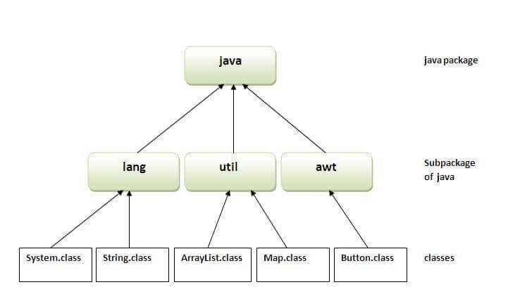

Slide 56
How to access package from another package?
There are three ways to access the package from outside the package.
1. Import a specific class:
import java.util.Vector;
2. Import all classes from a package:
import java.util.*;
Note : This imports all classes and interfaces from the java.util package but does not include sub-packages.

Slide 57
3. Using fully qualified name
Ex. Java.util.Scanner sc = new java.util.Scanner(System.in)
If you use fully qualified name then only declared class of this package will be accessible.
Now there is no need to import.
But you need to use fully qualified name every time when you are accessing the class or interface.

Slide 58
User-defined Packages
1. Create the Package:
First we create a directory myPackage (name should be same as the name of the package).
Then create the MyClass inside the directory with the first statement being the package names.

Slide 59
// Name of the package must be same as the directory
// under which this file is saved
package myPackage;
public class MyClass
{
public void getNames(String s)
{
System.out.println(s);
}
}

Slide 60
2. Use the Class in Program:
// import 'MyClass' class from 'names' myPackage
import myPackage.MyClass;
public class Geeks {
public static void main(String args[]) {
// Initializing the String variable
// with a value
String s = “Hello";
// Creating an instance of class MyClass in
// the package.
MyClass o = new MyClass();
o.getNames(s);
}
}

Slide 61
Types of Errors in Java
Errors are severe issues that occur at compile time or runtime and are beyond the control of the programmer. These are mainly caused by the environment or system failure.

Slide 62
Common Types of Errors:
Compile-time Errors – Errors detected by the compiler (e.g., syntax errors, missing semicolons).
Runtime Errors – Errors occurring during program execution.
Logical Errors – Incorrect logic leading to unintended behavior.
OutOfMemoryError – When JVM runs out of memory.
StackOverflowError – Infinite recursion leading to stack overflow.

Slide 63
Compile-Time Errors
public class CompileTimeErrorExample {
public static void main(String[] args) {
System.out.println("Hello World")
}
}
These errors occur due to incorrect syntax or missing components in the code and are detected by the compiler.

Slide 64
Runtime Errors
public class RuntimeErrorExample {
public static void main(String[] args) {
int result = 10 / 0; // Division by zero -> Runtime error
System.out.println(result);
}
}

Slide 65
Logical Errors
public class LogicalErrorExample {
public static void main(String[] args) {
int num1 = 5, num2 = 10;
int sum = num1 - num2; // Incorrect logic, should be num1 + num2
System.out.println("Sum: " + sum);
}
}
These errors do not crash the program but produce incorrect output due to wrong logic.

Slide 66
OutOfMemoryError
import java.util.ArrayList;
import java.util.List;
public class OutOfMemoryErrorExample {
public static void main(String[] args) {
List<String> list = new ArrayList<>();
while (true) {
list.add("OutOfMemoryError"); // Keeps adding to the list, consuming memory
}
}
}

Slide 67
StackOverflowError
public class StackOverflowErrorExample {
public static void recursiveMethod() {
recursiveMethod(); // Infinite recursion
}
public static void main(String[] args) {
recursiveMethod();
}
}
Occurs when a method calls itself indefinitely, leading to excessive memory consumption.

Slide 68
Exception Handling
What is Exception Handling?
Exception handling in Java is a mechanism that allows a program to handle runtime errors, ensuring that the normal flow of execution is not disrupted.

Slide 69
Need for Exception Handling in Java
Exception handling is a crucial feature in Java that ensures the smooth execution of programs by handling unexpected errors.
Without exception handling, an error can cause a program to terminate abruptly, leading to data loss, security risks, and poor user experience.

Slide 70
To Prevent Program Crashes
If an exception occurs and is not handled, the Java Virtual Machine (JVM) will terminate the program. Exception handling allows us to catch errors and continue program execution.
public class NoExceptionHandling {
public static void main(String[] args) {
int result = 10 / 0; // Runtime exception (Divide by zero)
System.out.println("This will not be printed.");
}
}

Slide 71
To Provide Meaningful Error Messages
If an exception occurs, Java provides a default error message, which might not be user-friendly. With exception handling, we can show a custom error message.
public class ExceptionHandlingExample {
public static void main(String[] args) {
try {
int result = 10 / 0; // Exception occurs
} catch (ArithmeticException e) {
System.out.println("Error: Cannot divide by zero.");
}
System.out.println("Program continues...");
}
}

Slide 72
To Handle Unexpected Scenarios
Certain errors may occur only in specific conditions, such as:
Network failures (e.g., lost internet connection)
File handling errors (e.g., file not found)
Database connectivity issues (e.g., server down)
Exception handling helps in gracefully managing such situations.
import java.io.File;
import java.io.FileNotFoundException;
import java.util.Scanner;
public class FileExceptionExample {
public static void main(String[] args) {
try {
File file = new File("non_existent_file.txt");
Scanner reader = new Scanner(file);
} catch (FileNotFoundException e) {
System.out.println("Error: File not found.");
}
}
}

Slide 73
Types of Exceptions in Java
Checked Exceptions (Compile-time exceptions)
Must be handled using try-catch or declared using throws.
Example: IOException, SQLException.
Unchecked Exceptions (Runtime exceptions)
Occur due to logical errors in code.
Example: NullPointerException, ArithmeticException.
Errors
Serious problems that the program cannot recover from.
Example: OutOfMemoryError, StackOverflowError

Slide 74
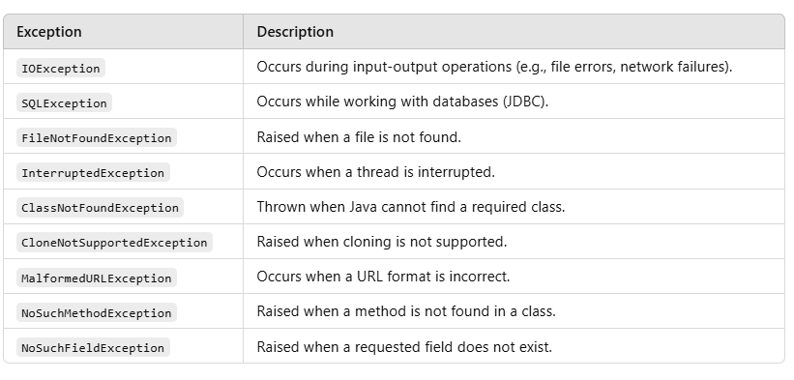
Checked Exceptions (Compile-Time Exceptions)

Slide 75
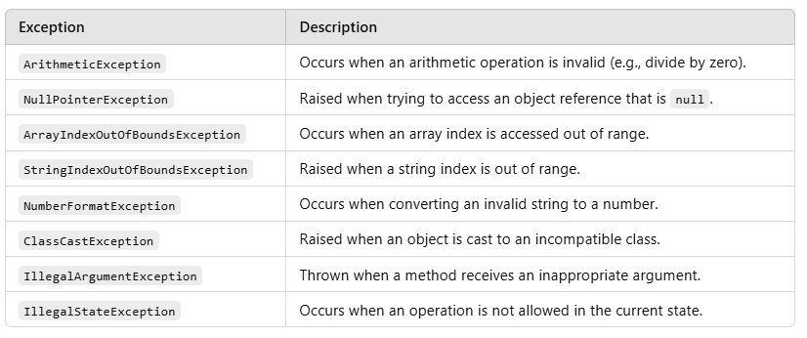
Unchecked Exceptions (Compile-Time Exceptions)

Slide 76
Exception Handling Keywords
Java provides five keywords for handling exceptions:
try
catch
finally
throw
throws

Slide 77
try-catch Block
The try block contains the code that may throw an exception. The catch block handles the exception.
public class TryCatchExample {
public static void main(String[] args) {
try {
int result = 10 / 0;
System.out.println(result);
} catch (ArithmeticException e) {
System.out.println("Error: Cannot divide by zero.");
}
System.out.println("Program continues...");
}
}

Slide 78
Multiple catch Blocks
A try block can have multiple catch blocks to handle different exceptions separately.

Slide 79
public class MultipleCatchExample {
public static void main(String[] args) {
try {
int[] arr = {1, 2, 3};
System.out.println(arr[5]); // This will throw ArrayIndexOutOfBoundsException
}
catch (ArithmeticException e) {
System.out.println("Arithmetic Exception caught.");
}
catch (ArrayIndexOutOfBoundsException e) {
System.out.println("Array index is out of bounds.");
}
catch (Exception e) {
System.out.println("Some other exception occurred.");
}
}
}

Slide 80
finally Block
The finally block is always executed, whether an exception occurs or not.
public class FinallyExample {
public static void main(String[] args) {
try {
int num = 10 / 0;
} catch (ArithmeticException e) {
System.out.println("Exception caught: " + e);
} finally {
System.out.println("Finally block executed.");
}
}
}

Slide 81
throw Keyword
The throw keyword is used to explicitly throw an exception.
public class ThrowExample {
static void checkAge(int age) {
if (age < 18) {
throw new ArithmeticException("Not eligible to vote.");
} else {
System.out.println("Eligible to vote.");
}
}
public static void main(String[] args) {
checkAge(16); // This will throw an exception
}
}

Slide 82
throws Keyword
The throws keyword is used in method declarations to specify that a method may throw an exception.
import java.io.IOException;
public class ThrowsExample {
static void readFile() throws IOException {
throw new IOException("File not found.");
}
public static void main(String[] args) {
try {
readFile();
} catch (IOException e) {
System.out.println("Exception handled: " + e.getMessage());
}
}
}

Slide 83
User-Defined Exception
In Java, we can create our own custom exceptions (user-defined exceptions) by extending the Exception class or RuntimeException class. This helps in handling specific application-related errors in a meaningful way.

Slide 84
Why Use User-Defined Exceptions?
More Meaningful Error Messages – Default exceptions like NullPointerException and IOException may not always be clear for specific use cases.
Improves Readability – Helps distinguish between different types of errors.
Enforces Business Logic – Ensures specific conditions are met in an application.

Slide 85
Steps to Create a User-Defined Exception
Create a class that extends Exception (for checked exceptions) or RuntimeException (for unchecked exceptions).
Define a constructor that calls the superclass constructor (super(message)).
Throw this exception in the program when needed using the throw keyword.
Catch and handle the exception using try-catch.

Slide 86
// Step 1: Create a custom exception class
class AgeException extends Exception {
public AgeException(String message) {
super(message); // Calling Exception class constructor
}
}
// Step 2: Use the custom exception in a method
public class UserDefinedExceptionExample {
static void validateAge(int age) throws AgeException {
if (age < 18) {
throw new AgeException("Age must be 18 or above."); // Throwing custom exception
} else {
System.out.println("You are eligible.");
}
}
public static void main(String[] args) {
try {
validateAge(16); // Passing an invalid age
} catch (AgeException e) {
System.out.println("Exception: " + e.getMessage());
}
}
}

Slide 87
// Step 1: Create a custom unchecked exception class
class InsufficientBalanceException extends RuntimeException {
public InsufficientBalanceException(String message) {
super(message);
}
}
// Step 2: Use the custom exception in a method
public class CustomRuntimeException {
static void withdraw(double balance, double amount) {
if (amount > balance) {
throw new InsufficientBalanceException("Insufficient balance in account.");
} else {
System.out.println("Withdrawal successful! Remaining balance: " + (balance - amount));
}
}
public static void main(String[] args) {
withdraw(5000, 7000); // Trying to withdraw more than balance
}
}

Slide 88
thread in java
In Java, a thread is the smallest unit of execution in a program. It allows a program to perform multiple tasks simultaneously, making it possible to achieve multithreading (running multiple threads at the same time).

Slide 89
Benefits of Multithreading in Java
Increased Performance & Responsiveness
Multiple threads can execute tasks simultaneously, reducing execution time.
UI applications remain responsive, avoiding "freezing" when performing heavy tasks (e.g., downloading a file).
Better CPU Utilization
A single-threaded program may leave the CPU idle while waiting for I/O operations.
Multithreading keeps the CPU busy by running other threads in parallel.

Slide 90
Faster Execution (Concurrency)
Tasks like sorting large datasets, handling network requests, or rendering graphics can be split into multiple threads, reducing processing time.
Example: A web server handles multiple requests simultaneously using threads.
Efficient Resource Sharing
Threads of the same process share memory & resources, reducing memory consumption compared to creating multiple processes.
Example: A music player can play songs while also allowing browsing of the playlist.

Slide 91
Real-Life Example: How Microsoft Word Uses Multithreading
Auto-Saving While Typing (Background Thread)
Spell & Grammar Checking (Separate Thread)
Formatting & UI Updates (Parallel Processing)
Printing in the Background
Auto-Correction & Word Suggestions
Multitasking with Multiple Documents

Slide 92
Thread Life Cycle in Java (Thread States)
In Java, a thread always exists in any one of the following states. These states are:
New
Active
Blocked / Waiting
Timed Waiting
Terminated

Slide 93
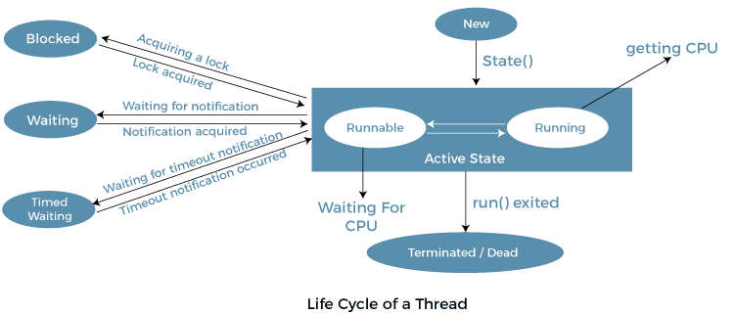

Slide 94
New: Whenever a new thread is created, it is always in the new state.
For a thread in the new state, the code has not been run yet and thus has not begun its execution.
Active: When a thread invokes the start() method, it moves from the new state to the active state.
The active state contains two states within it: one is runnable, and the other is running.

Slide 95
Runnable: A thread, that is ready to run is then moved to the runnable state.
In the runnable state, the thread may be running or may be ready to run at any given instant of time.
It is the duty of the thread scheduler to provide the thread time to run, i.e., moving the thread the running state.
Running: When the thread gets the CPU, it moves from the runnable to the running state.
Generally, the most common change in the state of a thread is from runnable to running and again back to runnable.
Blocked or Waiting: Whenever a thread is inactive for a span of time (not permanently) then, either the thread is in the blocked state or is in the waiting state.

Slide 96
Terminated: A thread reaches the termination state because of the following reasons:
When a thread has finished its job, then it exists or terminates normally.
Abnormal termination: It occurs when some unusual events such as an unhandled exception or segmentation fault.

Slide 97
ways to create a thread
By Extending Thread Class
By Implementing Runnable Interface

Slide 98
Thread Class
The simplest way to create a thread in Java is by extending the Thread class and overriding its run() method.
Thread class provide constructors and methods to create and perform operations on a thread.

Slide 99
Constructors of Thread Class
Thread()
Thread(String name)
Thread(Runnable r)
Thread(Runnable r, String name)

Slide 100
Thread Class Methods
public void run(): is used to perform action for a thread.
public void start(): starts the execution of the thread.JVM calls the run() method on the thread.
public void sleep(long miliseconds): Causes the currently executing thread to sleep (temporarily cease execution) for the specified number of milliseconds.
public void join(): waits for a thread to die.

Slide 101
public int getPriority(): returns the priority of the thread.
public int setPriority(int priority): changes the priority of the thread.
public String getName(): returns the name of the thread.
public void setName(String name): changes the name of the thread.
public Thread currentThread(): returns the reference of currently executing thread.
public int getId(): returns the id of the thread.
public boolean isAlive(): tests if the thread is alive.
public void yield(): causes the currently executing thread object to temporarily pause and allow other threads to execute.
public void suspend(): is used to suspend the thread(depricated).
public void resume(): is used to resume the suspended thread(depricated).
public void stop(): is used to stop the thread(depricated).

Slide 102
Creating Thread by Extending Thread Class
class Multi extends Thread
{
public void run()
{
System.out.println("thread is running...");
}
public static void main(String args[])
{
Multi t1=new Multi();
t1.start();
}
}

Slide 103
Write a program that executes two threads. One thread displays “Thread1” every 1000 milliseconds, and the other displays “Thread2” every 2000 milliseconds. Create the threads by extending the Thread class

Slide 104
Write a program that executes two threads. One thread will print the even numbers and another thread will print odd numbers from 1 to 200.

Slide 105
implementing Runnable interface
The Runnable interface is used for multithreading in Java.
Instead of extending the Thread class, we implement Runnable and pass an instance to a Thread object.

Slide 106
Steps to Implement Runnable Interface
Create a class that implements Runnable.
Override the run() method to define the task for the thread.
Create an instance of the class and pass it to a Thread object.
Call start() on the Thread object to begin execution.

Slide 107
public class ExampleClass implements Runnable {
@Override
public void run() {
System.out.println("Thread has ended");
}
public static void main(String[] args) {
ExampleClass ex = new ExampleClass();
Thread t1= new Thread(ex);
t1.start();
System.out.println("Hi");
}
}

Slide 108
Thread priority
Each thread has a priority. Priorities are represented by a number between 1 and 10.
In most cases, the thread scheduler schedules the threads according to their priority (known as preemptive scheduling).
But it is not guaranteed because it depends on JVM specification that which scheduling it chooses.
Note that not only JVM a Java programmer can also assign the priorities of a thread explicitly in a Java program.

Slide 109
Setter & Getter Method of Thread Priority
Let's discuss the setter and getter method of the thread priority.
public final int getPriority(): The java.lang.Thread.getPriority() method returns the priority of the given thread.
public final void setPriority(int newPriority): The java.lang.Thread.setPriority() method updates or assign the priority of the thread to newPriority.
The method throws IllegalArgumentException if the value newPriority goes out of the range, which is 1 (minimum) to 10 (maximum).

Slide 110
constants defined in Thread class:
public static int MIN_PRIORITY
public static int NORM_PRIORITY
public static int MAX_PRIORITY
Default priority of a thread is 5 (NORM_PRIORITY). The value of MIN_PRIORITY is 1 and the value of MAX_PRIORITY is 10.

Slide 111
class MyThread extends Thread {
public void run() {
System.out.println(getName() + " Priority: " + getPriority());
}
}
public class ThreadPriorityExample {
public static void main(String[] args) {
MyThread t1 = new MyThread(), t2 = new MyThread(), t3 = new MyThread();
t1.setPriority(1); t2.setPriority(5); t3.setPriority(10);
t1.start(); t2.start(); t3.start();
}
}

Slide 112
File Handling in Java
In Java, a File is an abstract data type. A named location used to store related information is known as a File.
There are several File Operations like creating a new File, getting information about File, writing into a File, reading from a File and deleting a File.

Slide 113
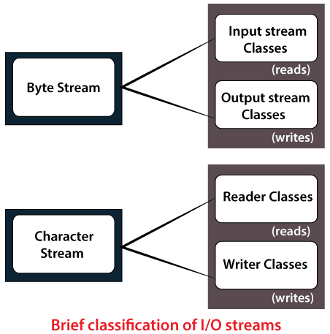
Stream
A series of data is referred to as a stream. In Java, Stream is classified into two types, i.e., Byte Stream and Character Stream.

Slide 114
Byte Stream
Byte Stream is mainly involved with byte data. A file handling process with a byte stream is a process in which an input is provided and executed with the byte data.
Character Stream
Character Stream is mainly involved with character data. A file handling process with a character stream is a process in which an input is provided and executed with the character data.

Slide 115
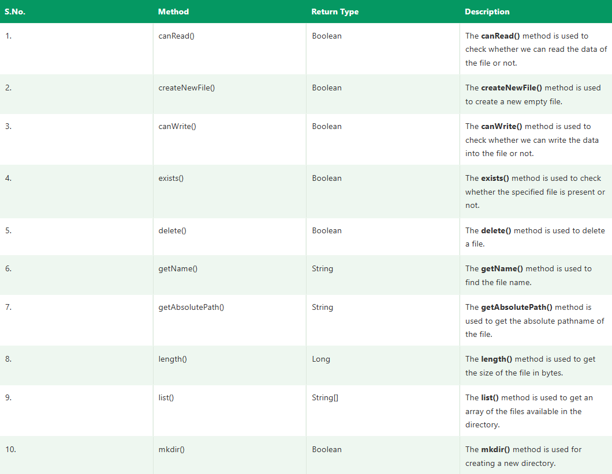

Slide 116
File Operations
We can perform the following operation on a file:
Create a File
Get File Information
Write to a File
Read from a File
Delete a File

Slide 117
import java.io.File;
import java.io.IOException;
class CreateFile {
public static void main(String args[]) {
try {
File f0 = new File("D:FileOperationExample.txt");
if (f0.createNewFile()) {
System.out.println("File " + f0.getName() + " is created successfully.");
} else {
System.out.println("File is already exist in the directory.");
}
} catch (IOException exception) {
System.out.println("An unexpected error is occurred.");
exception.printStackTrace();
}
}
}

Slide 118
import java.io.File;
class FileInfo {
public static void main(String[] args) {
File f0 = new File("D:FileOperationExample.txt");
if (f0.exists()) {
System.out.println("The name of the file is: " + f0.getName());
System.out.println("The absolute path of the file is: " + f0.getAbsolutePath());
System.out.println("Is file writeable?: " + f0.canWrite());
System.out.println("Is file readable " + f0.canRead());
System.out.println("The size of the file in bytes is: " + f0.length());
} else {
System.out.println("The file does not exist.");
}
}
}

Slide 119
import java.io.FileWriter;
import java.io.IOException;
class WriteToFile {
public static void main(String[] args) {
try {
FileWriter fwrite = new FileWriter("D:FileOperationExample.txt");
fwrite.write("A named location used to store related information is referred to as a File.");
fwrite.close();
System.out.println("Content is successfully wrote to the file.");
} catch (IOException e) {
System.out.println("Unexpected error occurred");
e.printStackTrace();
}
}
}

Slide 120
import java.io.File;
import java.io.FileNotFoundException;
import java.util.Scanner;
class ReadFromFile {
public static void main(String[] args) {
try {
File f1 = new File("D:FileOperationExample.txt");
Scanner dataReader = new Scanner(f1);
while (dataReader.hasNextLine()) {
String fileData = dataReader.nextLine();
System.out.println(fileData);
}
dataReader.close();
} catch (FileNotFoundException exception) {
System.out.println("Unexcpected error occurred!");
exception.printStackTrace();
}
}
}

Slide 121
import java.io.File;
class DeleteFile
{
public static void main(String[] args)
{
File f0 = new File("D:FileOperationExample.txt");
if (f0.delete()) {
System.out.println(f0.getName()+ " file is deleted successfully.");
}
else {
System.out.println("Unexpected error found in deletion of the file.");
}
}
}

